Slide 1
GENIUS 3rd year
Report for WP1
L. Balaguer
Universitat de Barcelona / FBG

Slide 2
Management
This package provides the overall administrative management of GENIUS.
This work package includes the administrative tasks to fulfil the EC requirements and rules as well as the global administrative tasks inside the consortium, including financial management, intellectual property management and project documentation. These tasks are carried out by the GENIUS coordinator assisted by a hired project manager.

Slide 3
T1.1 Global administrative tasks
Task leader: UB
General tasks:
coordination of EC reporting,
maintenance of the TWiki internal information system,
management of the WebEx teleconferencing system,
financial management of the project,
tracking of the project technical requirements and schedule through monthly teleconferences.

Slide 4
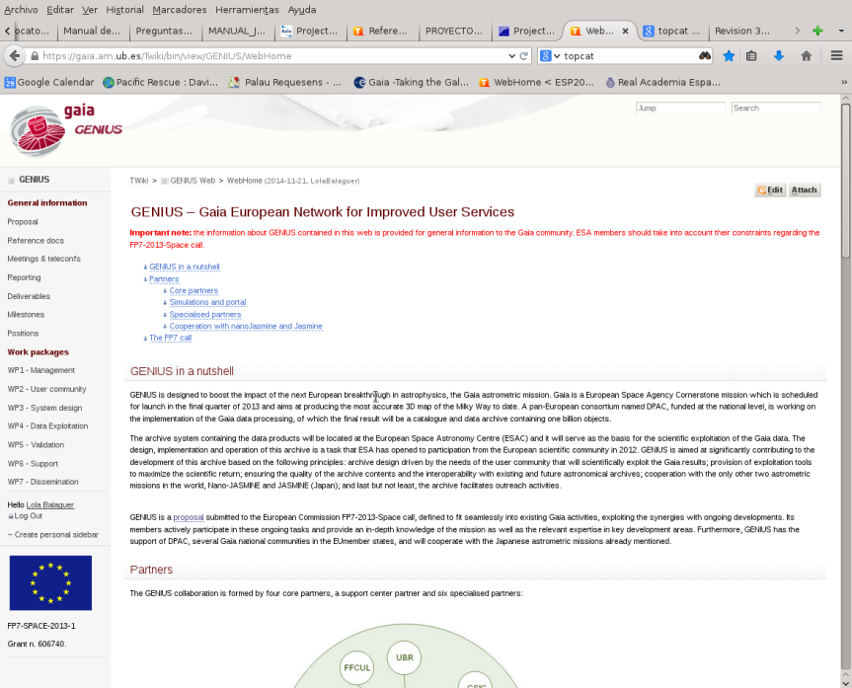
Coordination
Twiki system developed for internal information management
https://gaia.am.ub.es/Twiki/bin/view/GENIUS/
SVN Internal repository for file management at UB server

Slide 5
Work - life balance
Commitments on DOW "5.1.Providing for good work–life balance" in GENIUS: "One of the causes for the present distribution is the relatively more limited availability of women, many of who for whatever reason end up siding with their families and are less mobile, both nationally and internationally. In order to counter this, we propose to allow for more but shorter trips and *virtual international contacts*."
Required equipment to make this happen:
Webex licence for teleconferences and
Philips Conference Microphone LFH-9172
Monthly progress tracking teleconferences
A total of 60 teleconferences in the three years

Slide 6
Meetings and telecons
KOM organized in Barcelona (Dec 2013)
Joint Gaia CU9-GENIUS meeting in order to fully integrate the GENIUS activities in the overall Gaia DPAC effort, (Vienna Jul 2014)
GENIUS First year review (Brussels Dec 2014)
Gaia Archive Review #1: joint meeting with ESAC Science Archives (Madrid Jan 2015)
Coordination meeting (ESA-GENIUS-CU9) for cross-match activities (Rome Feb 2015)
Joint GENIUS-CU9 Plenary Meeting (Barcelona Sep 2015)
GENIUS Second year review (Barcelona Oct 2015)
Mid-term external review (Leiden Nov 2015)
GENIUS Third year review (Sitges Jan 2017)
External Advisory Board review, ?? March 2017
Final Review Meeting, Brussels end of April 2017

Slide 7
Reporting
We have developed a reporting system where we report every three months to the project officer from the information collected by each WP on our Twiki..
Semestral report 1 – May 2014
Semestral report 2 – First year report Nov 2014
Semestral report 3 – May 2015
Semestral report 4 – Second year repot Oct 2015
Semestral report 5 – May 2016
Semestral report 6 – Dec 2016
Pending trimestral reports
October – December 2016
January – March 2017

Slide 8
Effort
Effort of all the nodes per WP (% of total)

Slide 9
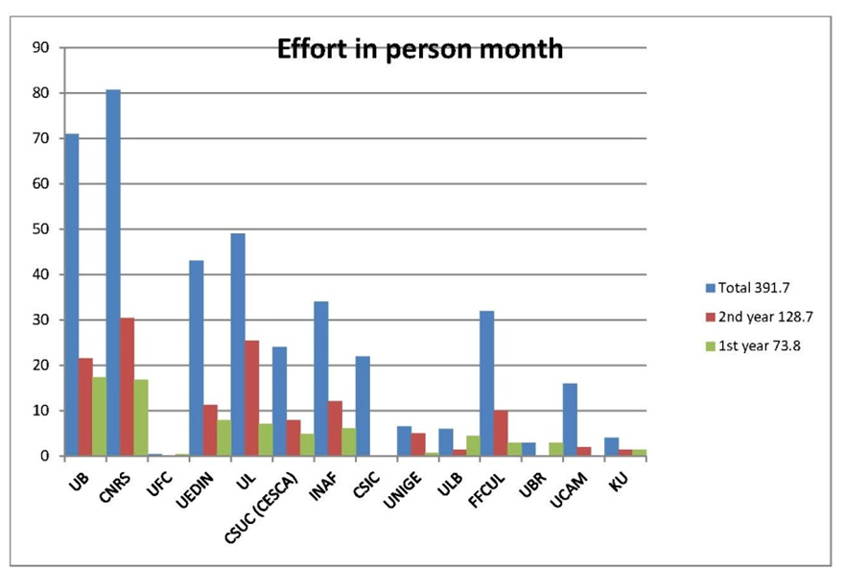
Total project effort in pm, 1st and 2nd year effort

Slide 10
Expected effort
Pending effort of all the nodes per WP after 2nd year report
Was a 48% of total effort:
Some partners had finished their effort
UFC
ULB
UBR
General understanding that they
continue with some other Gaia support
Some partners had pending more than 50%:
CSIC was changed by INTA. Most of the pending
effort when to UB (2 new contracts working effectively
In INTA Madrid but paid by UB)
UCAM

Slide 11
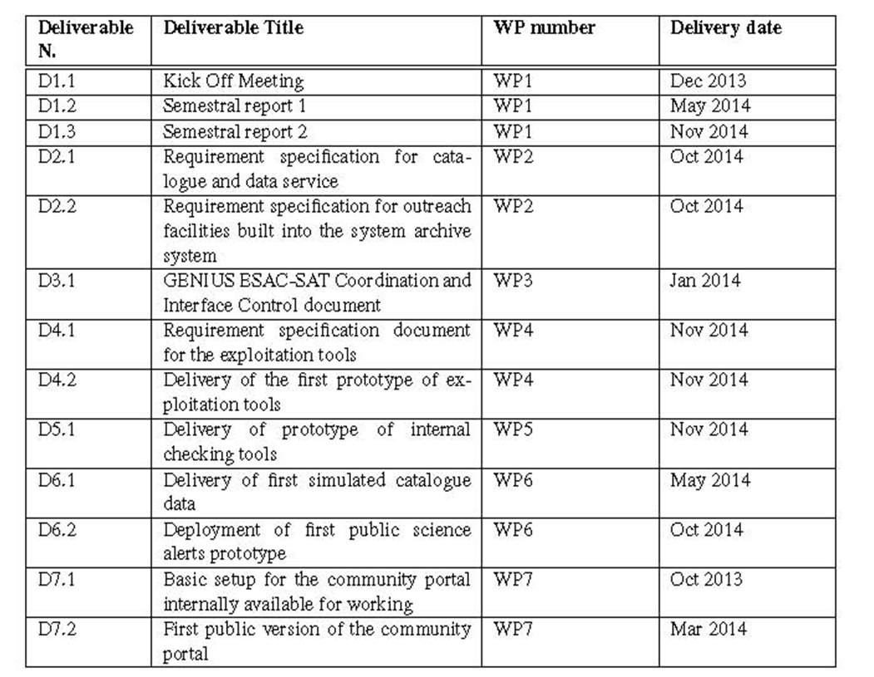
First year Deliverables

Slide 12
Second year Deliverables

Slide 13
Third year Deliverables
Deliverable N. | Deliverable Title | WP number | Deliverable date
D1.8 | Semestral report 6 | WP1 | 15/12/2016
D2.7 | Requirements specification for the archiving of raw and intermediate data | WP2 | 15/12/2016
D2.8 | Requirements specification for the archiving of the original software with which the archive was produced. | WP2 | 15/12/2016
D5.4 | Delivery of statistical tools | WP5 | 29/11/2016
D5.5 | Delivery of model-based validation tools | WP5 | 29/11/2016
D5.7 | Delivery of external validation tools | WP5 | 29/11/2016
D5.8 | Delivery of special object tools | WP5 | 15/12/2016
D6.3 | Delivery of second simulated catalogue data | WP6 | 11/04/2016
D6.5 | Delivery of third simulated catalogue data | WP6 | 20/11/2016
D6.6 | Deployment of third public science alerts prototype | WP6 | 20/11/2016

Slide 14
Final Deliverables
Deliverable N. | Deliverable Title | WP number | Deliverable date
D1.9 | Completion Meeting (plenary) | WP1 | 01/03/2017
D1.10 | Final report to the External Advisory Board | WP1 | 31/03/2017
D1.11 | Report on dynamics of the gender balance | WP1 | 31/03/2017
1 deliverable pending WP2
5 deliverables pending WP3
1 deliverable pending WP4
1 deliverable pending WP5
0 deliverables pending WP6
1 deliverable pending WP7

Slide 15
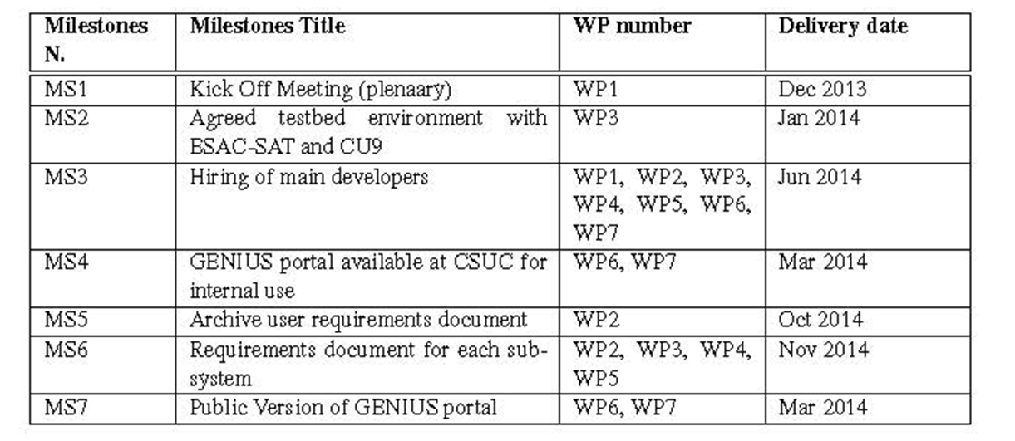
Milestones

Slide 16
Pending Milestones
Milestone N. | Milestone Title | WP number | Delivery date
MS13 | Stress test | WP3 | 31/12/2016
MS14 | Load of actual Gaia data | WP3, WP5 | 01/01/2017
MS15 | Completion meeting & final external review | WP1 | 01/03/2017
MS16 | GENIUS products availability | ALL | 31/01/2017
MS17 | Handover of GENIUS portal to Gaia community | WP7 | 31/01/2017

Slide 17
Travel costs
Only money to spend after March 2017 is
travelling costs to Brussels for final review

Slide 18
Gender
Keeping in mind the principles of the European Charter for Researchers and the Code of Conduct for recruitment. It has taken place in a globally coordinated way and placing an emphasis on individual excellence and capacity for team working and taking special care to ensure equal opportunity and gender balance.
In computer science projects, the IAU statistics show that a 16% female staff is the average. In the GENIUS hiring we have managed to improve this percentage to 25% in the newly hired personnel (calculated by number of contracts not FTEs).
External Advisory Committee: 1 out of 4.

Slide 19
Gender
Deliverable D1.11 Report on dynamics of the gender balance. (01/04/2017)
→ need of inputs from WPs (number of women contracted, ratio of interviewed women for positions…)

